Slide 1

Notes:
This should be the title slide for all corporate presentations pertaining to the overall university level

Slide 2

Faculty of Engineering and Technology
Department of Computer Science and Design
Notes:
This is the title slide for respective colleges/institutions while we retain the DMIHER logo on top always.

Slide 3

Presentation for Major Project

Slide 4
PRESENTATION FOR MAJOR PROJECT
TOPIC SLEEP APNEA PREDICTION USING MACHINE LEARNING
NAME OF STUDENT: MANSI SHARMA
NAME OF THE SUPERVISOR: MR. CHETAN PURI
DEPARTMENT OF COMPUTER SCIENCE AND DESIGN,
FACULTY OF ENGINEERING AND TECHNOLOGY, SAWANGI (MEGHE) , WARDHA
DATE :18-10-2024

Slide 5
CONTENTS
Introduction
Prisma Chart
Prisma-S Extension
Knowledge /Research gap analysis
Knowledge/Research Gap Summary
Nature of the Knowledge Gap Identified
Research Question
Aim
Objectives
Methodology
Quarterly Scheduling of Research Work
Publication Schedule
References

Slide 6
INTRODUCTION
Sleep apnea is a common but serious sleep disorder that affects millions of people worldwide. It is characterized by repeated interruptions in breathing during sleep, leading to poor sleep quality and various health complications, including cardiovascular diseases, diabetes, and chronic fatigue.
Traditional methods of diagnosing sleep apnea, such as polysomnography, are time-consuming, expensive, and require specialized equipment. With the rise of machine learning (ML) technologies, there is potential to develop automated, cost-effective, and non-invasive solutions for predicting sleep apnea.

Slide 7
INTRODUCTION
we aim to build a machine learning model to predict the likelihood of sleep apnea based on a range of features such as age, gender, occupation, sleep duration, quality of sleep, physical activity level, stress level, BMI, blood pressure, heart rate, and daily steps.
By using a dataset containing labeled examples of individuals with and without sleep apnea, our model will classify new cases with high accuracy, assisting healthcare professionals in making more informed decisions.

Slide 8
SYMPTOMS
Symptoms of obstructive sleep apnea include:
Excessive daytime sleepiness.
Loud snoring.
Observed episodes of stopped breathing during sleep.
Waking during the night and gasping or choking.
Awakening in the morning with a dry mouth or sore throat.
Morning headaches.
Trouble focusing during the day.
Mood changes, such as depression or being easily upset.
High blood pressure.

Slide 9
SYSTEMATIC REVIEW OF LITERATURE (PRISMA FLOW DIAGRAM)
Identification
Articles identified through other sources SCIE/SCOPUS/Research Gate Sources (n=10)
Articles identifies through IEEE searching (n=20)
Records after duplicates removal (n=15)
Screening
Records screened for removal(n=15)
Article excluded:(n=5)
Records excluded(n=10)
Full text articles excluded with reasons: Objective is not matching.
Number of Full text articles assessed for eligibility (n=10)
Eligibility
Original articles-2
Review articles-3 Met analysis & SR-00
RCT-00
Books-5
Included
Number of Studies included in Qualitative and Quantitative (n=10)

Slide 10
PRISMA-S EXTENSION
Topic | Item | Checklist item
Data base name | 1 | PubMed, IEEE, Elsevier, Research Gate, Google Scholar
Registries | 2 | N/A
MESH TERMS | 3 | Sleep Apnea Syndromes, Obstructive Sleep Apnea, Machine Learning, Prediction Models, Sleep Disorders, Artificial Intelligence in Health.
Search strategies | 4 | Searches were conducted across multiple databases such as PubMed, IEEE Xplore, Google Scholar, and Scopus.
Selection process | 5 | Articles that specifically addressed sleep apnea prediction, used real-world datasets, or tested ML models with evaluation metrics like accuracy, AUC, or precision-recall curves.
Limits and restrictions | 6 | Only studies published between 2013-2023 were included to ensure the use of modern ML techniques.
Search filters | 7 | Studies include Machine Learning modern technology work and Sleep apnea disorders.
Total records | 8 | Journal articles, Research articles. A total of 20 literature is the part of the study.

Slide 11
RESEARCH ARTICLES INCLUDED
Sr. No | Type of article | Total
1 | Original Article | 10
2 | SR & MA | 00
3 | RCT | 00
4 | Review | 05
5 | Books | 05
Grand Total | Grand Total | 20

Slide 12
KNOWLEDGE GAP
S. No. | Title of the Article Author Year of publication | Focus of Study, Design, Objectives , Method used and Sample size | Findings of the study and their conclusions | Remarks of the Scholar on limitations
1 | Artificial intelligence techniques to predict the Sleep disorders illness: a systematic review. 2023 | Estimating obstructive sleep apnea syndrome (OSAS) severity. Machine learning method Random Forest, XGBoost is used . Using a dataset of 4014 patients, excellent classification accuracy | Restricted by the quality and accessibility of the data, possible bias in the dataset, and the model's applicability to a wide range of demographics. | Using a dataset of 4014 patients dataset, excellent classification accuracy for various severity criteria was attained.
2 | Recent progress in long-term sleep monitoring technology, 2023 | ECG signals to categorize sleep apnea. Here machine Learning is used. | A variety of machine learning methods were used to extract characteristics from ECG data and obtain good accuracy rates. | Certain features of sleep apnea may not be picked up by ECG signals, particularly when the condition is not accompanied by noticeable changes in heart rate.

Slide 13
KNOWLEDGE GAP
S. No. | Title of the Article Author Year of publication | Focus of Study, Design, Objectives , Method used and Sample size | Findings of the study and their conclusions | Remarks of the Scholar on limitations
3 | Derivation and validation of a simple perioperative sleep apnea prediction score | Utilizing wearable device data to predict sleep apnea. Deep Learning (CNNs) | It's possible that wearable technology won't record the entire spectrum of physiological data required for a precise diagnosis of sleep apnea. | CNNs were used to evaluate smartwatch data, and encouraging outcomes were obtained.
4 | Neural network prediction of obstructive sleep apnea from clinical criteria | Initial detection of sleep apnea. Support Vector Machines (SVM) | Restricted by the quality and accessibility of the data, possible bias in the dataset, and the model's applicability | created an SVM model using clinical and demographic data to forecast sleep apnea.

Slide 14
KNOWLEDGE GAP SUMMARY
Utilizing wearable device data to predict sleep apnea. Deep Learning (CNNs) [1-19] [22] [24]. created an SVM model using clinical and demographic data to forecast sleep apnea.
A variety of machine learning methods were used to extract characteristics from ECG data and obtain good accuracy rates.[3] [7-9] [11-13] [16-19]. Citation
Restricted by the quality and accessibility of the data, possible bias in the dataset, and the model's applicability to a wide range of demographics.[1-25].

Slide 15
NATURE OF THE KNOWLEDGE GAP IDENTIFIED
SN | Research Gap Types | Type of research gap used
1 | Knowledge Gap | Most models operate on historical data and are not designed for real-time monitoring and prediction.
2 | Methodological Gap | Many studies do not adequately validate their models across diverse datasets, leading to overfitting and poor generalization to unseen data.
3 | Practical –knowledge Gap | A significant practical knowledge gap in sleep apnea prediction using machine learning lies in the integration of diverse, real-world data sources. Most existing models rely on homogeneous datasets from clinical settings, limiting their applicability to varied demographics and lifestyles.
4 | Population Gap | The current body of research on sleep apnea prediction using machine learning often lacks diversity in study populations, primarily focusing on specific demographic groups such as middle-aged males or patients from urban healthcare settings.

Slide 16
RESEARCH QUESTION
How can machine learning algorithms be optimized to predict sleep apnea risk based on diverse demographic and lifestyle factors?

Slide 17
AIM
The aim of this project is to develop a robust machine learning model for predicting sleep apnea risk by integrating diverse datasets, including clinical, lifestyle.

Slide 18
OBJECTIVES
To collect and integrate diverse datasets, including clinical records , and lifestyle factors, to create a comprehensive database for model training.
To identify and select the most significant features that contribute to sleep apnea prediction, focusing on clinical indicators, and lifestyle habits.
18

Slide 19
Methodology & Flowchart
Start
End
Data Collection
Data Pre-processing
You are suffering from sleep apnea, please concern with Doctor ☹
Model Selection and Training
Yes
No
Calculating Model Accuracy and printing classification report
prediction[0] == 0
You are Healthy ☺
Dumping model in pickle file
Give the input to streamlit website
Error
Flowchart

Slide 20
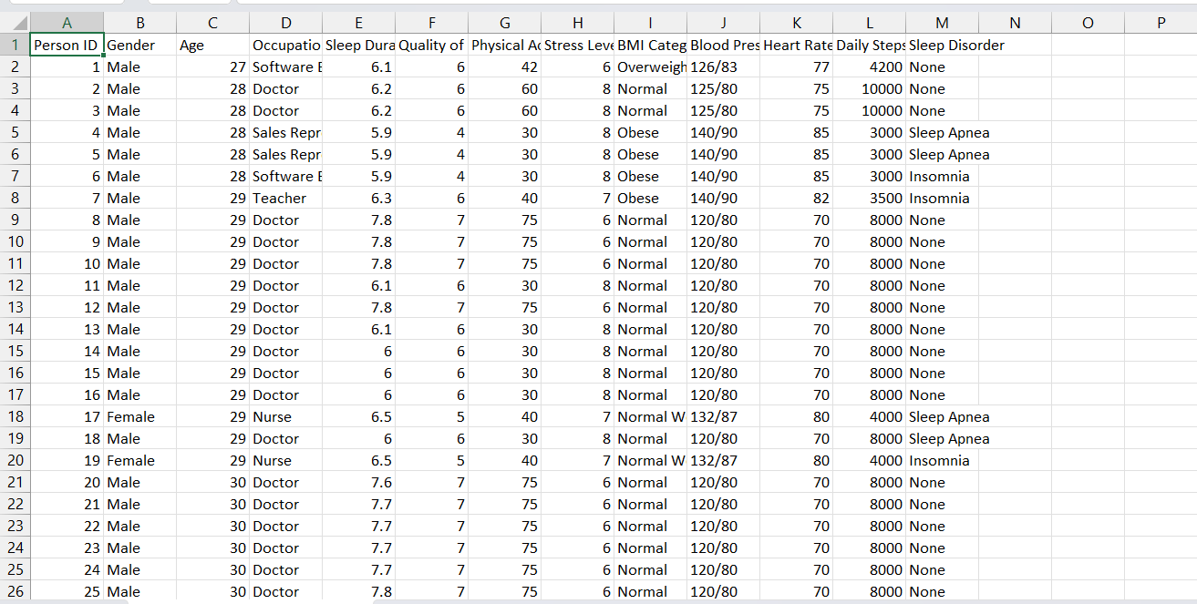
Result
Dataset used
Source – Kaggle
Dataset Name - Sleep_health_and_lifestyle_dataset
20

Slide 21
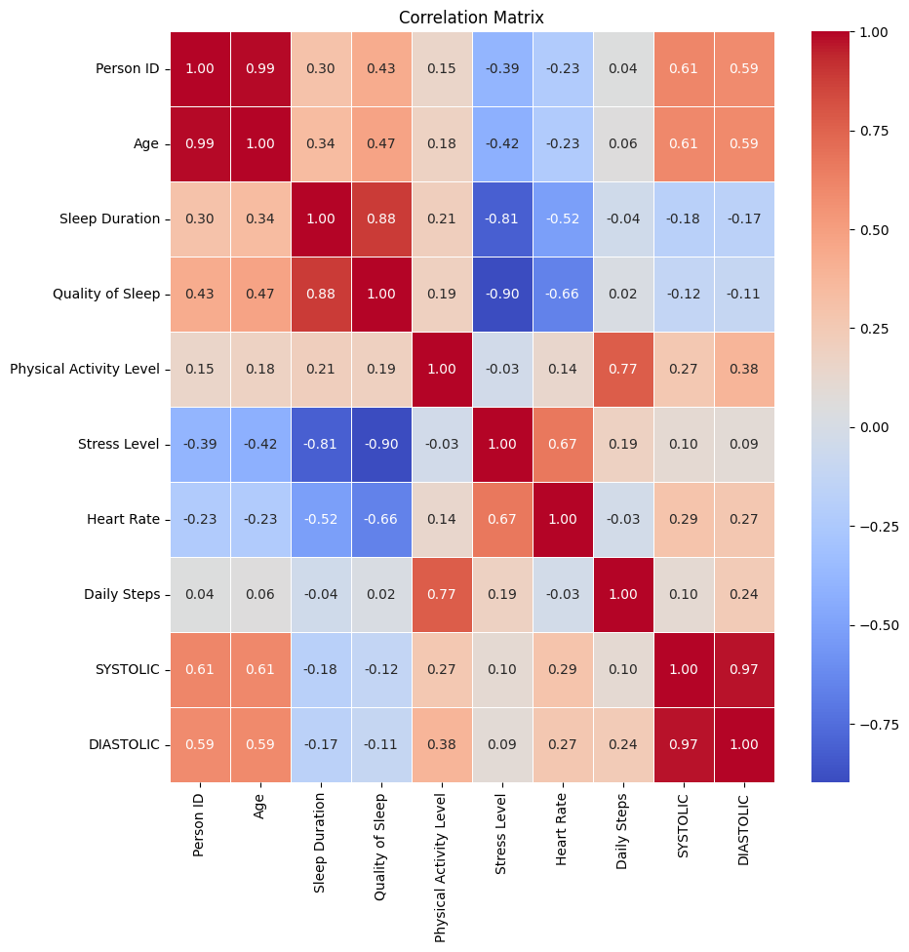
Result
Confusion Matrix
21

Slide 22
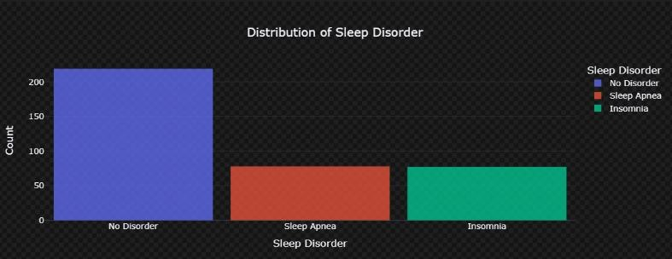
Result
Distribution of Sleep Disorder
22

Slide 23
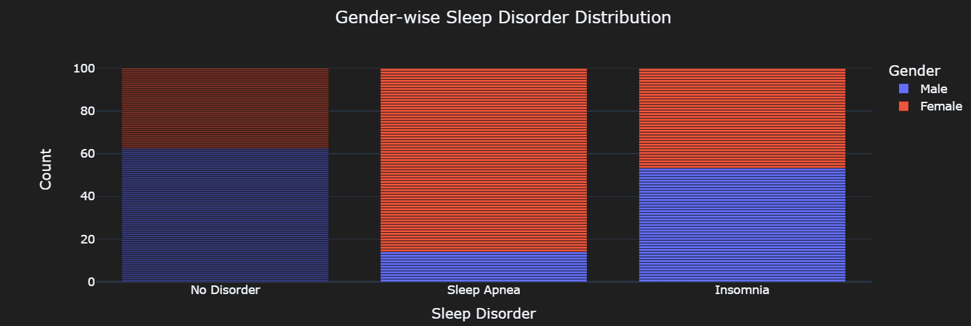
Result
Gender-wise Sleep Disorder Distribution
23

Slide 24
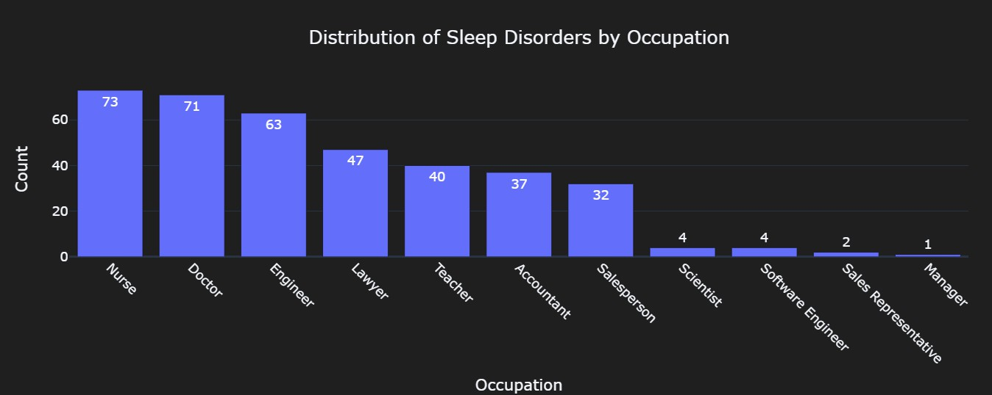
Result
Distribution of sleep Disorders by occupation
24

Slide 25
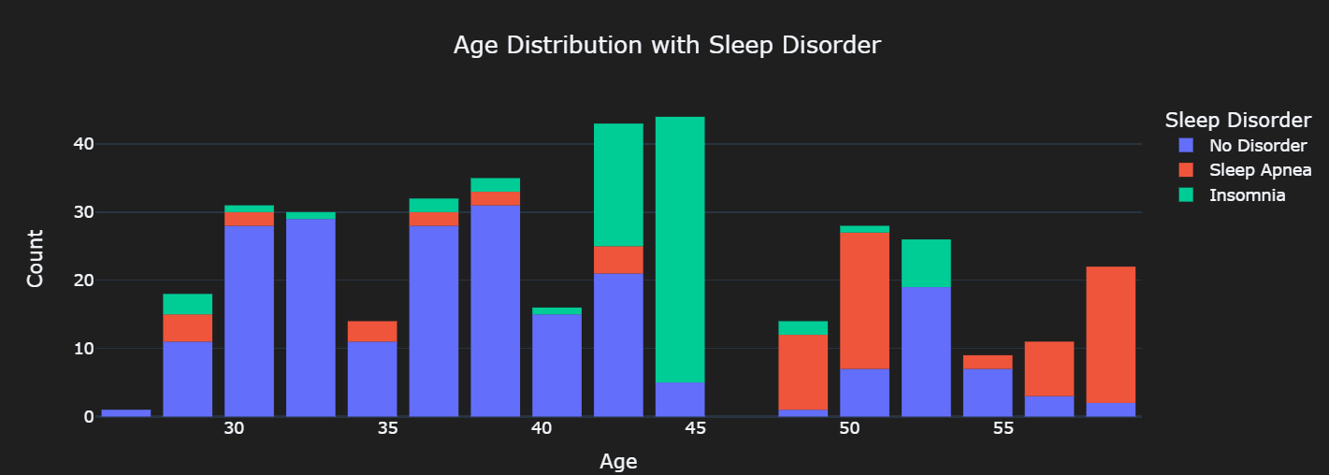
Result
Age Distribution with Sleep Disorder
25

Slide 26
Result
2. Model Selection and Training
Model | Accuracy | Precision | Recall | F-1 Score
Logistic Regression | 0.8434 | 0.8455 | 0.8434 | 0.8432
Decision Tree | 0.8788 | 0.8799 | 0.8788 | 0.8787
SVM | 0.5859 | 0.7384 | 0.5859 | 0.5824
Gradient Boosting | 0.8636 | 0.8651 | 0.8636 | 0.8637
Naïve Bayes | 0.8737 | 0.8888 | 0.8737 | 0.8746
26

Slide 27
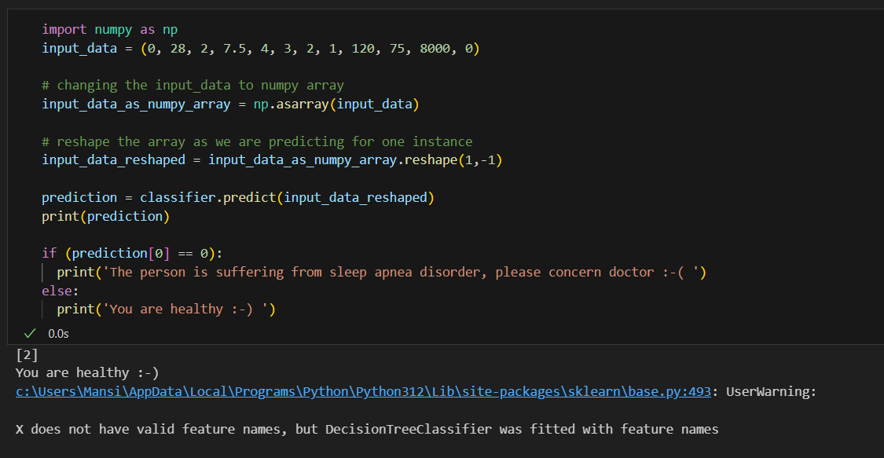
Result
3. Predictive Model
27

Slide 28
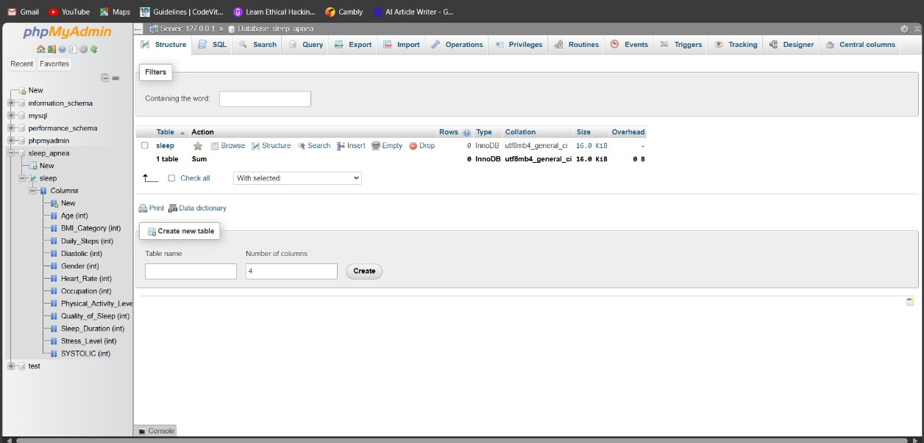
Result
28

Slide 29
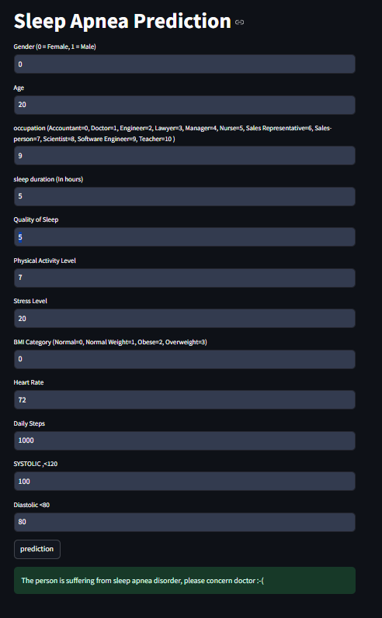
Result
URL : https://sleep-apnea-prediction-using-machine-learning.streamlit.app/
29

Slide 30
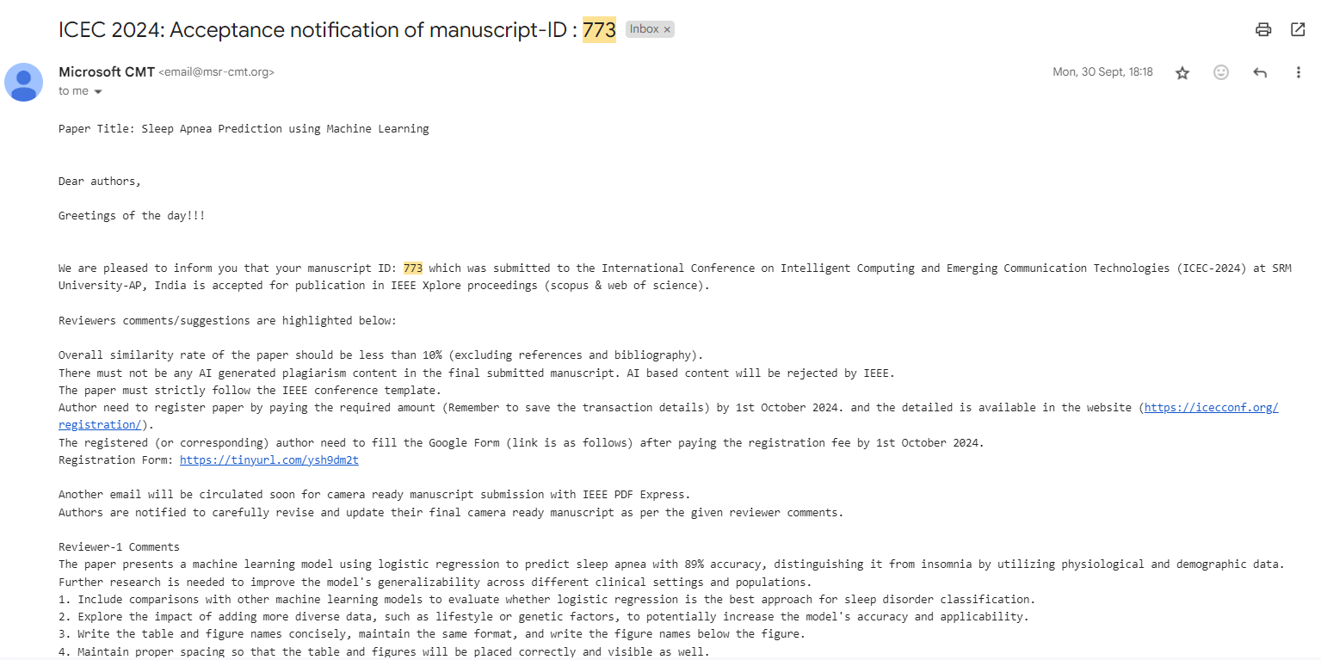
Proof of paper Submitted
November 23-25 (https://icecconf.org/ )
30

Slide 31
PUBLICATION PLAN
Sr. No. | Target | Month and Year
1 | Publication (Review Paper) in Scopus/SCI Journal | Presentation on November 2024
2 | Publication of Research Paper in IEEE Transaction/SCI/ SCOPUS Index Journal (One in each year) | Presentation on November 2024
3 | Presentation and Publication in Reputed IEEE/AIP /Web of Science Conferences (One in Each Quarter) | Presentation on November 2024
4 | Patent 01 if required | -
5 | Copyright at least 01 | Submitting November 2024
6 | External Funding Project at least 01 | -

Slide 32
SUMMARY
Sr. no | Point | Compliance
1 | Is research gap identified? | Yes
2 | Is the research question is in tune with research gap? | Yes
3 | Is the hypothesis in tune with the research question? | Yes
4 | Is the study design commensurate with the research question? | Yes
5 | Is the study feasible ? | Yes
6 | Whether the research lead to generation of new knowledge or achieve higher level of evidence? | Yes

Slide 33
REFERENCES
[1] Baur, D., et al., Decision support by machine learning systems for acute management of severely injured patients: a systematic review. 2022. 9: p. 924810.
[2] Montenegro, L., et al., Human-Assisted vs. deep learning feature extraction: an evaluation of ECG Features extraction methods for arrhythmia classification using machine learning. 2022. 12(15): p. 7404.
[3] Jain, G., Sleep Apnea detection using Deep Learning Methodologies. 2022, Dublin, National College of Ireland.
[4] Hafezi, M., et al., Sleep apnea severity estimation from tracheal movements using a deep learning model. 2020. 8: p. 22641-22649.
[5] Huang, W.-C., et al., Support vector machine prediction of obstructive sleep apnea in a large-scale Chinese clinical sample. 2020. 43(7): p. zsz295.
[6] Dutta, R., et al., A novel model to estimate key obstructive sleep apnea endotypes from standard polysomnography and clinical data and their contribution to obstructive sleep apnea severity. 2021. 18(4): p. 656-667.

Slide 34
THANK YOU

